Slide 1
Game Concept Development
Introduction to Game Design and Development
ITCS 4230/5230
Dr. Dewan Tanvir Ahmed
Department of Computer Science
University of North Carolina at Charlotte

Slide 2
“I cannot give you the formula for success, but I can give you the formula for failure, which is: try to please everybody.”
- Herbert Bayard Swope
“Walking is NOT game play.”
“What game is worth doing that's not creatively risky? ”
- Tim Schafer, Game Designer

Slide 3
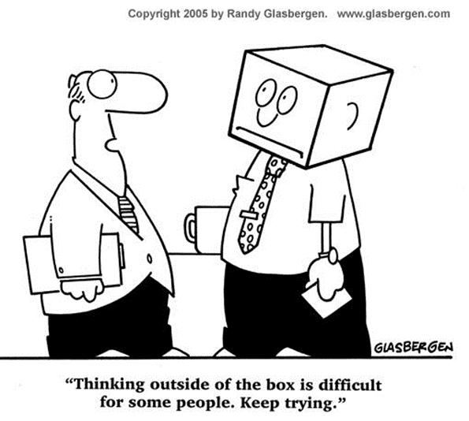
The Creative Process
What is creativity?
How can it be developed?
There are no definitive formulas or methodologies just several hundred years of good practice and natural selection

Slide 4
The Creative Process
How do we learn? (Particularly about creativity)
What occurs when we are creative?
Of course people are taught skills and ways of thinking
But particularly for the designer the need to identify personal values in order to be more creative is of paramount importance

Slide 5
The Conscious Competence Learning Model
A simple model of how we generally learn new skills.
derived from various psychological premises and formed by commercial training enterprises
It proposes four stages in the learning and mastery of a subject.
Conscious Competence Learning Model
Unconscious
Unskilled
Consciously
Skilled
Consciously
Unskilled
Unconsciously
Skilled

Slide 6
The Conscious Competence Learning Model
We lack the skills to attempt an activity and we don’t know what skills we need.
We have now developed the skills we need to perform the task, but we still have to focus on the task in order to complete it.
Unconscious
Unskilled
Consciously
Skilled
Consciously
Unskilled
Unconsciously
Skilled
After some exploration we now know what skills we need but still we are unable to perform the task
We now mastered the skills required to perform the task and can be deployed without thinking.

Slide 7
Coming Up with Ideas
An idea is just the beginning of the creative process
Coming up with ideas is difficult
Excellent ideas is even more difficult.
Part of Game Design
Crafting your ideas
fleshing them out, and
bringing them to life
layers and iterations of ideas are required
help to refine and evolve your original concept.
This process might be different for every game designer

Slide 8

Coming Up with Ideas (cont.)
Great ideas come from great input into your mind and senses
Not only playing games
but living a curious life, full of curiosity people, places, thoughts and events
Use your interest in something other than games to fill your mind with potential ideas.

Slide 9

Coming Up with Ideas (cont.)
Think Differently!
Look beyond your personal experience
Look beyond your personal preferences

Slide 10

Outside Influences
Look to as many non-game sources as possible
Art
Literature
Current affairs
They may not be mainstream, and sometimes undiscovered ‘gems’ might be found
History
Film
Television
Graphic Novels

Slide 11
Similarly Themed Games
Fashion styles are just as applicable to the game industry
Don’t just slavishly copy the idea, develop your own response
Is there a different aspect of the theme that has not been explored?
It might be time for a new ‘improved’ version

Slide 12
Mix and Match
Familiar tales in unfamiliar settings (and vice versa)
Unlikely objects, activities, stories and themes mixed together
Ask ‘what if’ questions?

Slide 13
Brand New Ideas
Can be deemed risky and untried
Strong ideas can achieve critical and commercial success
Independent developers appear to be very successful in this area

Slide 14
Coming Up with Ideas (cont.)
Suggestions:
spend a significant part of every day doing something other than playing games
read a book or a newspaper
watch a film, listen to music
travelling
take a photo
draw or sketch
volunteer at a neighborhood organization
go see a play
study a new language

Slide 15
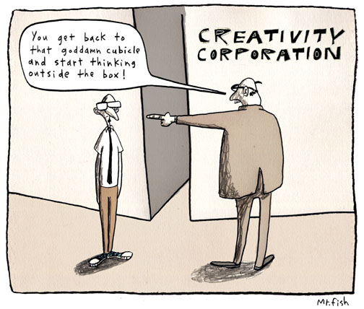

Coming Up with Ideas (cont.)

Slide 16
Coming Up with Ideas (cont.)
The stages of creativity (Mihaly Csikszentmihalyi)
Preparation – becoming immerse in a topic or domain of interest, a set of problematic issues
Incubations – Incubation is a period of time in which ideas “churn around” below the threshold of consciousness.
Insight – the “aha!” moment, when the pieces of the puzzles, or an idea, fall together
Evaluation – when the person decides whether the insight is valuable and worth pursuing. Is it really original?
Elaboration – the longest part of the creativity process; it takes the most time and is the hardest

Slide 17
Coming Up with Ideas (cont.)
The stages of creativity (Mihaly Csikszentmihalyi)
“The creative process is less linear than recursive. How many iterations it goes through, how many loops are involved, how many insights are needed, depends on the depth and breadth of the issues dealt with. Sometimes incubation lasts for years; sometimes it takes a few hours. Sometimes the creative idea includes one deep insight and innumerable small ones.”

Slide 18
Coming Up with Ideas (cont.)
Carry a notepad or PDA
So that they do not fade away after that initial moment of inspiration.
Ideas are ephemeral and might vanish before they are fully formed.

Slide 19
Coming Up with Ideas (cont.)
Evaluation and Elaboration—are just as important as the initial insight
iNSiGHT - I want to make a game studying Chinese!
Evaluation ?
Elaboration ?

Slide 20
Coming Up with Ideas (cont.)
Ideas also come from analyzing existing games and activities
Develop your critical skills (not just think “cool!”)
Read - Link
Pay close attention to your emotional responses, to your cycle of frustration, exhilaration, confidence, etc.
Discuss games with friends, deconstruct games, etc.
Begin a game journal

Slide 21
Concept Development
Most games begin with a single idea.
Questions to answer -
How you intend to entertain someone through gameplay?
Why you believe it will be compelling experience?

Slide 22
Concept Development
The idea can revolve around
A character
It would be cool to play James Bond!
Gameplay
How about a squad-based action game?
Philosophy
Explore the horrors of biology gone mad!
New technology
Let’s create a dancing game that captures the player’s movements in the real world and superimposes them on a model in the game world.

Slide 23
Coming Up with Ideas (cont.) - Rephrase
Source of idea
Friend, coworker, or publisher, or from deep in your own subconscious
Complete Original idea?
Consumers are always looking for something new and different.
Yet a paradox
If you do have something truly original, it might be worth fighting for.
It took Will Wright four years to find a game company willing to distribute SimCity, Broderbund finally took it on in 1989.

Slide 24

Inspirational Images
Woodland
Ecological issues
Forest sim
Bio diversity
(serious games)
Myths and fairytales
Sasquatch
Woodland creature RPG?
Adapted from:

Slide 25

Inspirational Images
Leaves
Patterns
Sunlight
Branching growing
Leaf maze
Catch the most sunlight
Wind in leaves, musical
Elemental instruments
Adapted from:

Slide 26

Inspirational Images
Glass Mosaic
Formal pattern
Tessellating shapes
Mirror, reflection, refraction puzzle?
Crystal maze
Trapped
Adventure in surreal mirror world?
Adapted from:

Slide 27

Inspirational Images
Swan
Regal
Moving pattern
Give birds character
Serene on the surface, legs busy paddling hidden beneath the surface
‘The Swans’ secret society
Adapted from:

Slide 28
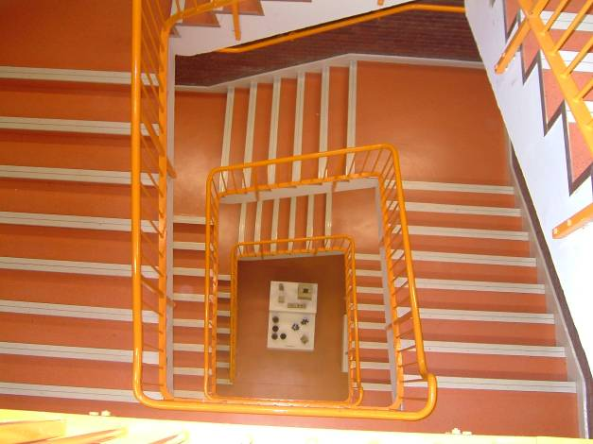
Inspirational Images
Stairwell
Confusing perspectives
Level puzzle?
Institutionalized
Impersonal
Prison
Jail sim?
Jail break adventure?
Adapted from:

Slide 29
The Game Proposal Document
An idea will eventually evolve into the high concept of the game.
The result of the concept development phase is the game proposal
It’s like the executive summary of what you want to accomplish
Concept Development
Proposal Document

Slide 30
Proposal Document
Summary (a.k.a. high concept)
Pitch (a.k.a. proposal or concept doc)

Slide 31
Proposal Document
High Concept
One or two sentences
It’s “the vision thing.”
State what your game is about
Notes:
A couple of sentences are all you’ll get on the game box to tell a prospective customer why he should put
it in his shopping cart rather than back on the shelf.
1. Think of how many people shop for PC games.
2. Think of a game executive as one of those shoppers.

Slide 32
Examples of High Concept
A busty female archaeologist pursues ancient treasure.
(Tomb Raider)
Ping-Pong on the computer. (Pong)
An ordinary technician battles trans-dimensional monsters after an accident at a secret research facility. (Half-Life)
A street-racing game where you drive a getaway car for the mob. (Driver)

Slide 33
Proposal Document
Genre
A single sentence that places the game within a genre, or a hybrid of genres.

Slide 34
Proposal Document
Gameplay: goals, rules, challenges,
actions, progression
Summarizes what the player will do when he’s playing the game.

Slide 35
Proposal Document
Features: controls, perspective, visual
style, special weapons, etc.
Highlight major selling points
List technical advancement
It tells people what’s inside the box.

Slide 36
Proposal Document
Settings
Summarize game world, occupants, and uniqueness
Story
If it has story – add a quick synopsis of what happens.
Character

Slide 37
Proposal Document
Target audience
Whom are you developing the game?
Is it a niche market of specialized genre fans?
The mass market? Kids? Sports fans?
Platform
For PC game list the target hardware requirements -
memory and processor speed

Slide 38
Proposal Document
Competition
What games have come out in this genre? How did they sell?
Why will yours do better or worse?
What competition will your game have to face when it comes out?
How will your game stack up against the competition and survive the fierce battle for shelf space?

Slide 39
Proposal Document
Estimated budget and schedule
Hard part
Estimating the schedule and budget of a software project is part science, part art.
Team
Summarize the credentials of your team and its key individuals -designer, tech lead, art lead, and so on
Emphasize their skills (very important)

Slide 40
Proposal Document
Risk Analysis
Lays out all the things that can go wrong and how you plan to deal with problems that might arise
Some issues:
Difficulties recruiting personnel
Late delivery of console dev-kits
Reliance on external sources for key technology components
Changes in the installed base of the target platform
Competitive technology developments

Slide 41
Proposal Document
Summary
Emphasize again the high points of your game
The ability of your team to deliver a quality product, on time and on budget

Slide 42
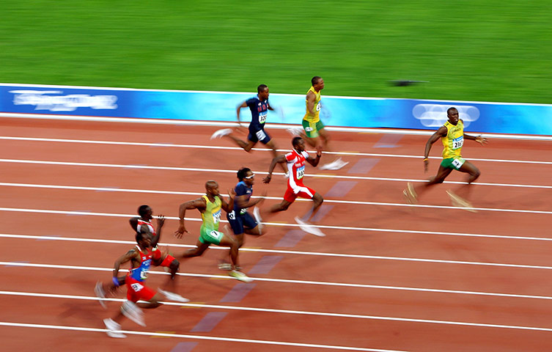
Game Designer
If you want to be a game designer, think of yourself as an Olympic contestant in the sport of idea brainstorming.

Slide 43
Thank you!

